Slide 1
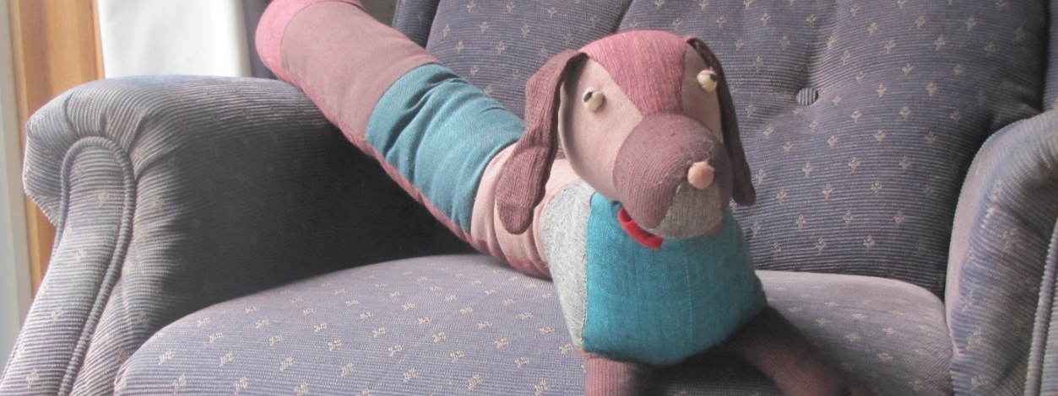
How the dog got his name
By David W. Lankshear

Slide 2
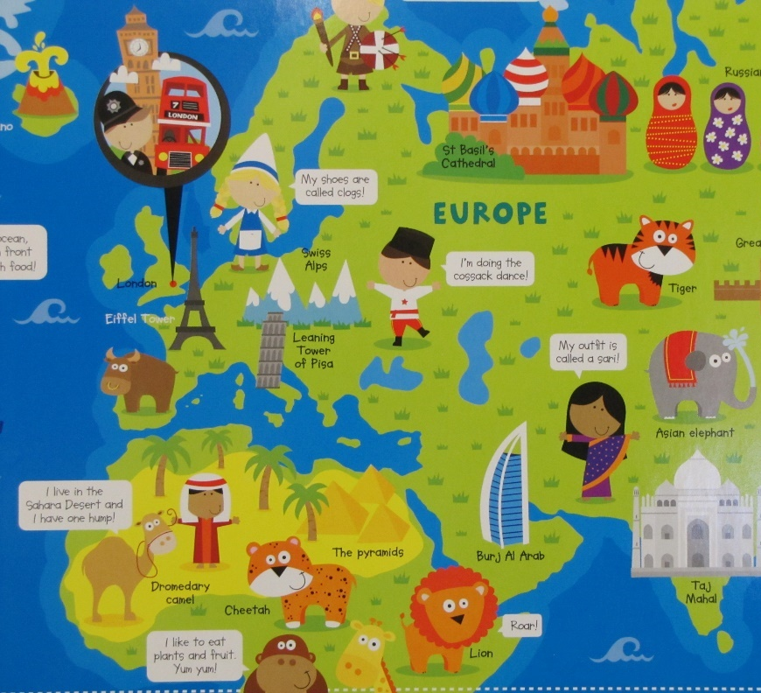
The dog arrived at Granny and Grandad’s house after a long journey. It came from Nepal.

Slide 3

The dog did not see much of the journey because he was inside a box, inside a container.

Slide 4
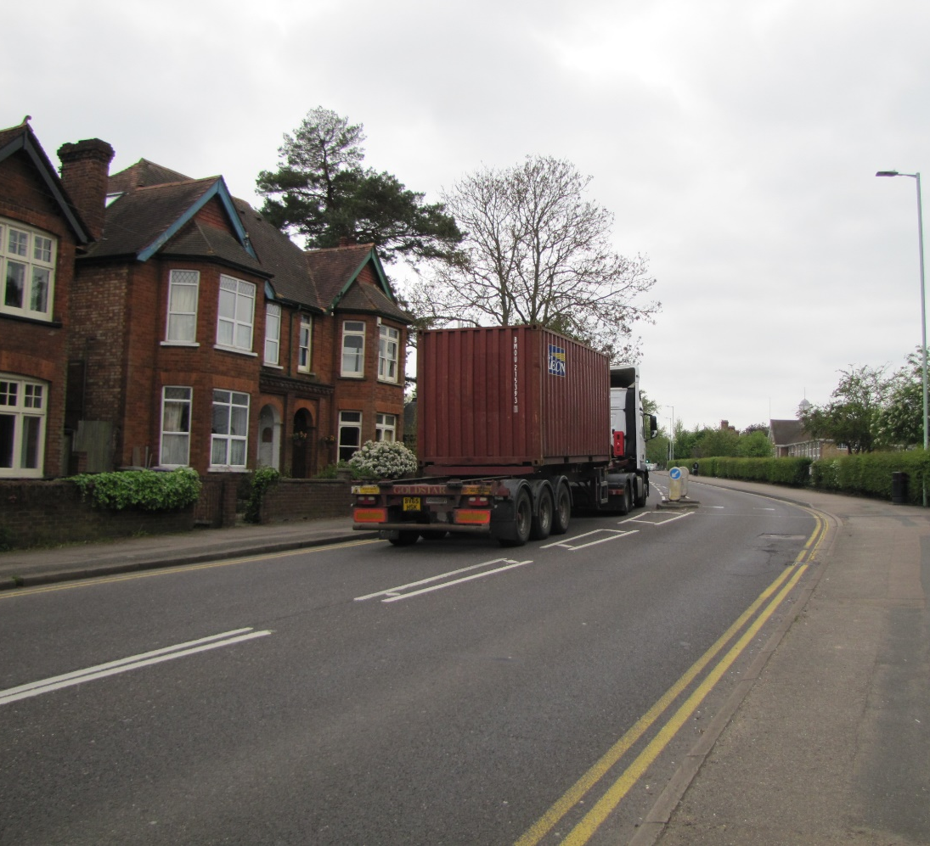
The container came on a ship and then on a lorry. Then the box was put in a van which brought it to Granny and Grandad’s house.
r

Slide 5
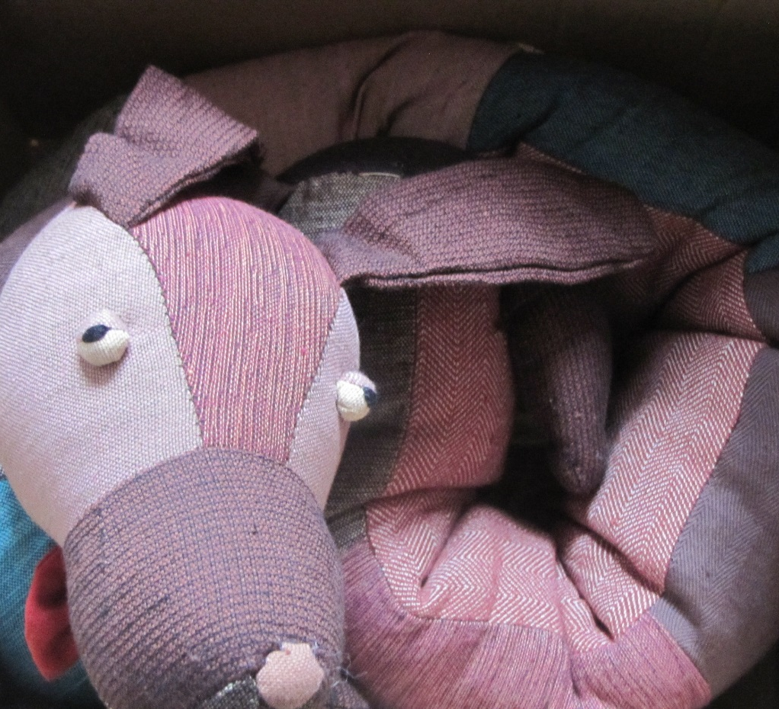
When Granny opened the box and saw the dog she said, “This is just what we need.”

Slide 6
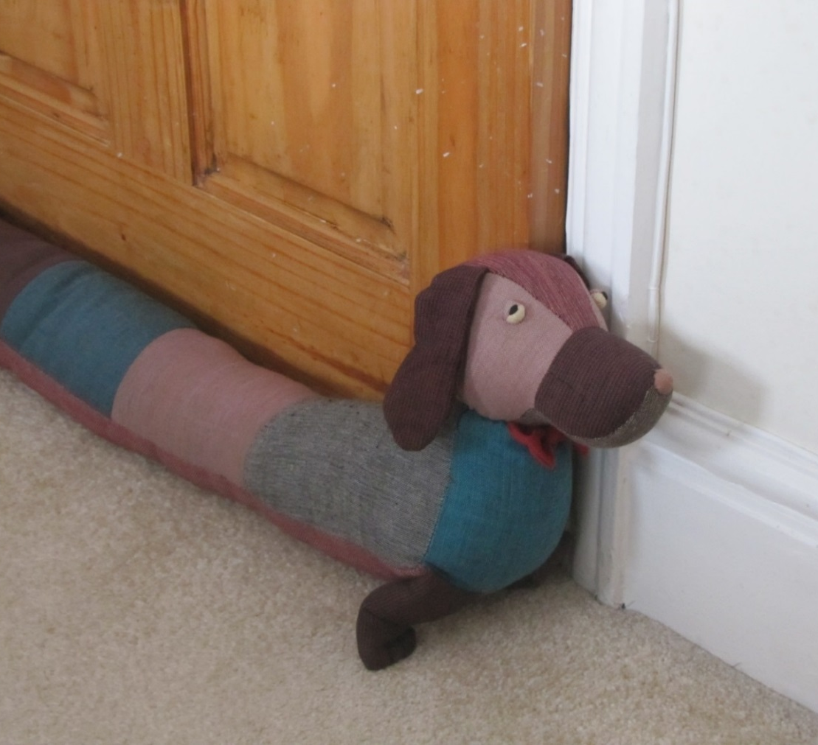
Granny placed the dog by the door. “There you are,” she said, “he is just the right size.” Grandad nodded.

Slide 7
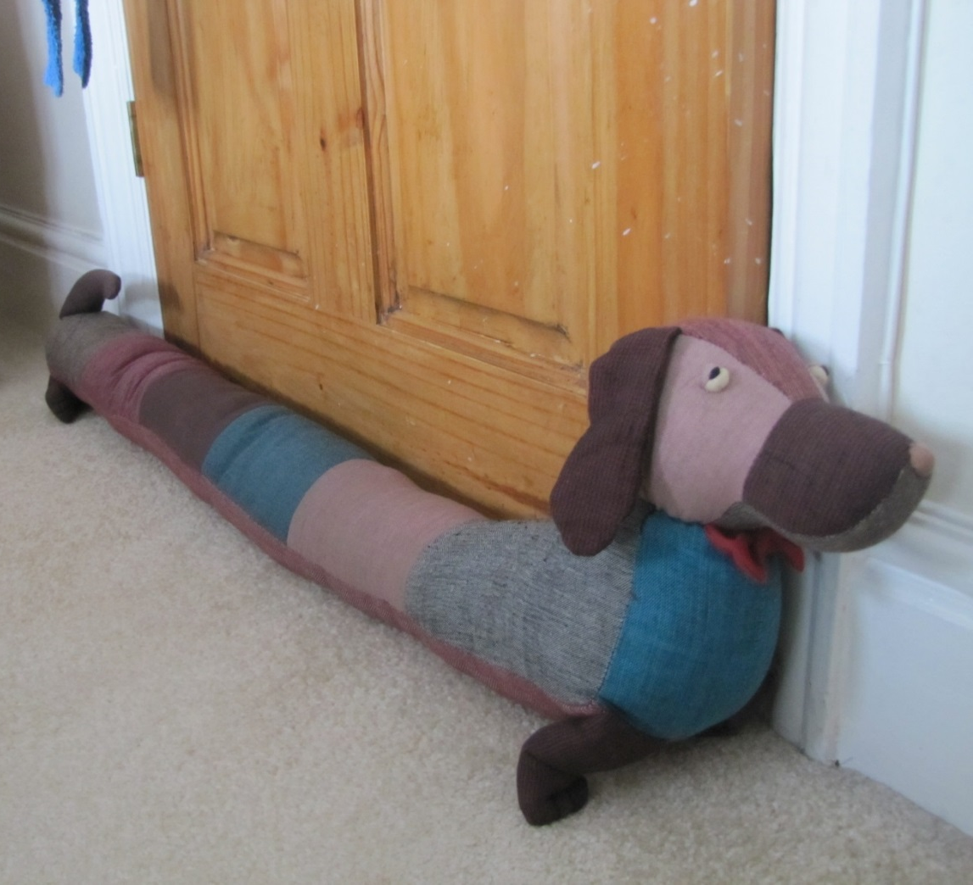
The dog was glad he was able to stretch out. He had been really cramped, curled up in his box.

Slide 8
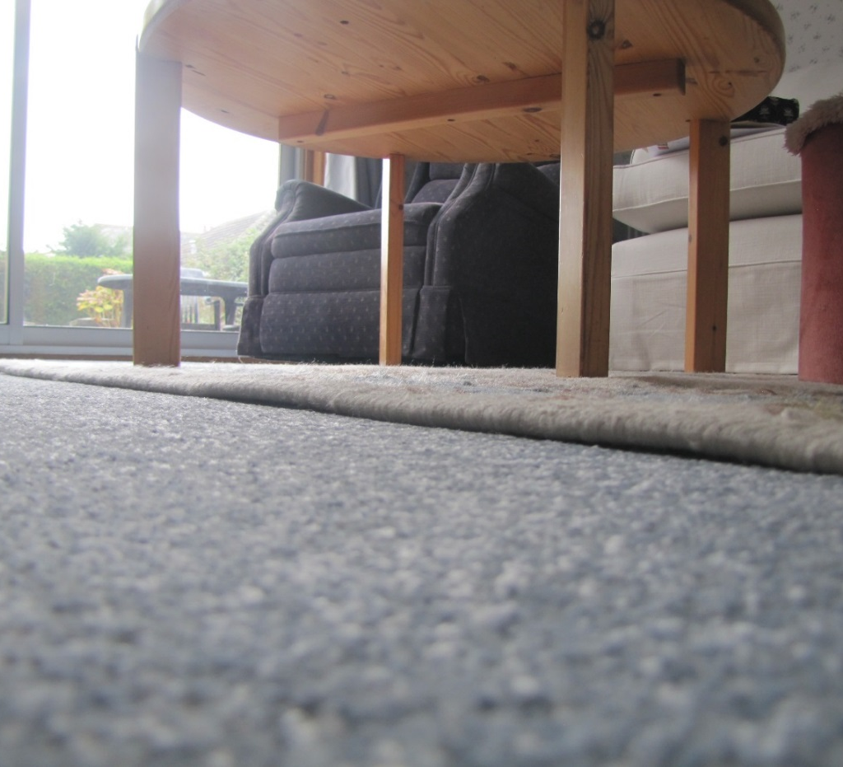
This is how the dog saw the world until the day Fran and James arrived.
.

Slide 9
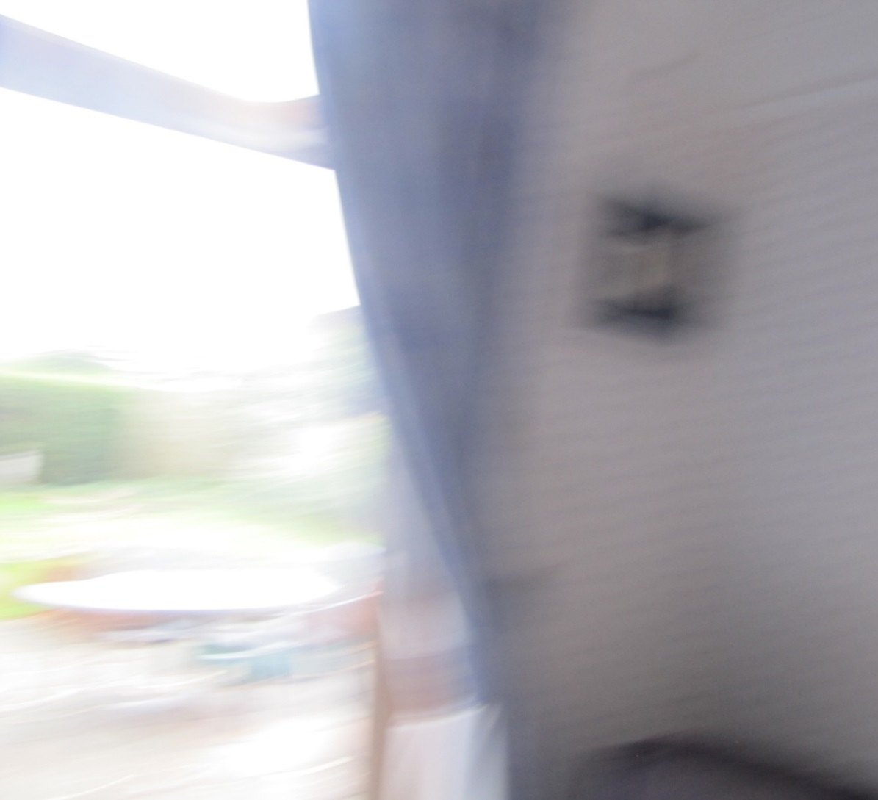
Then the dog saw the world like this as Fran picked him up and whirled him round.

Slide 10
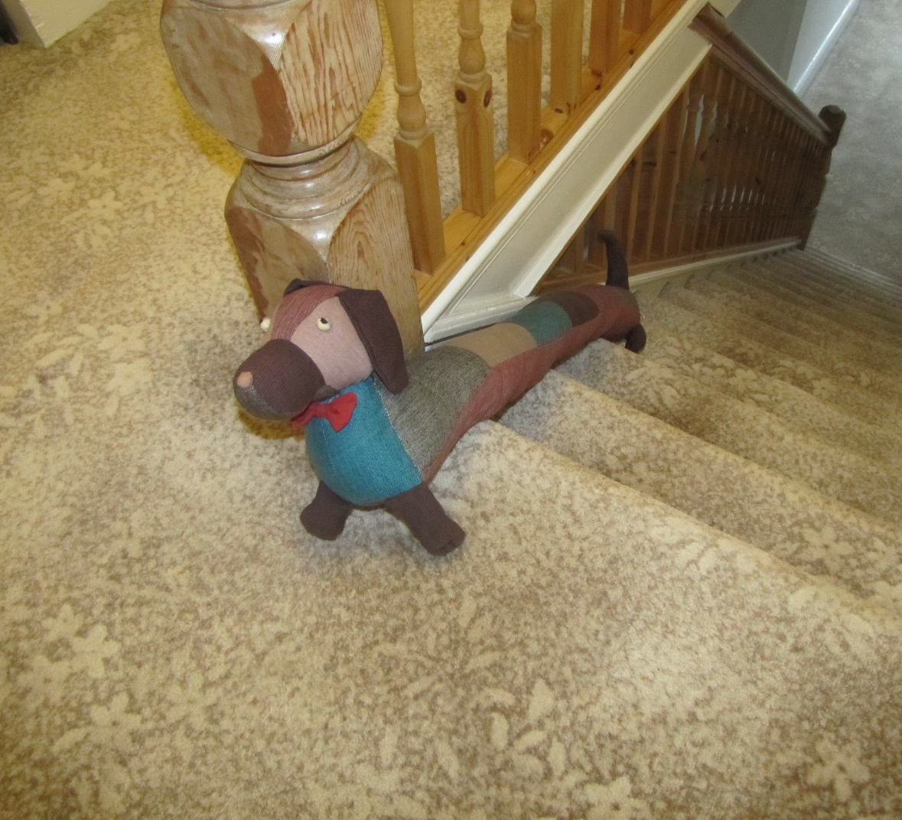
Fran made the dog go upstairs. It is hard to go upstairs when your front legs are on different stairs from your back legs.

Slide 11
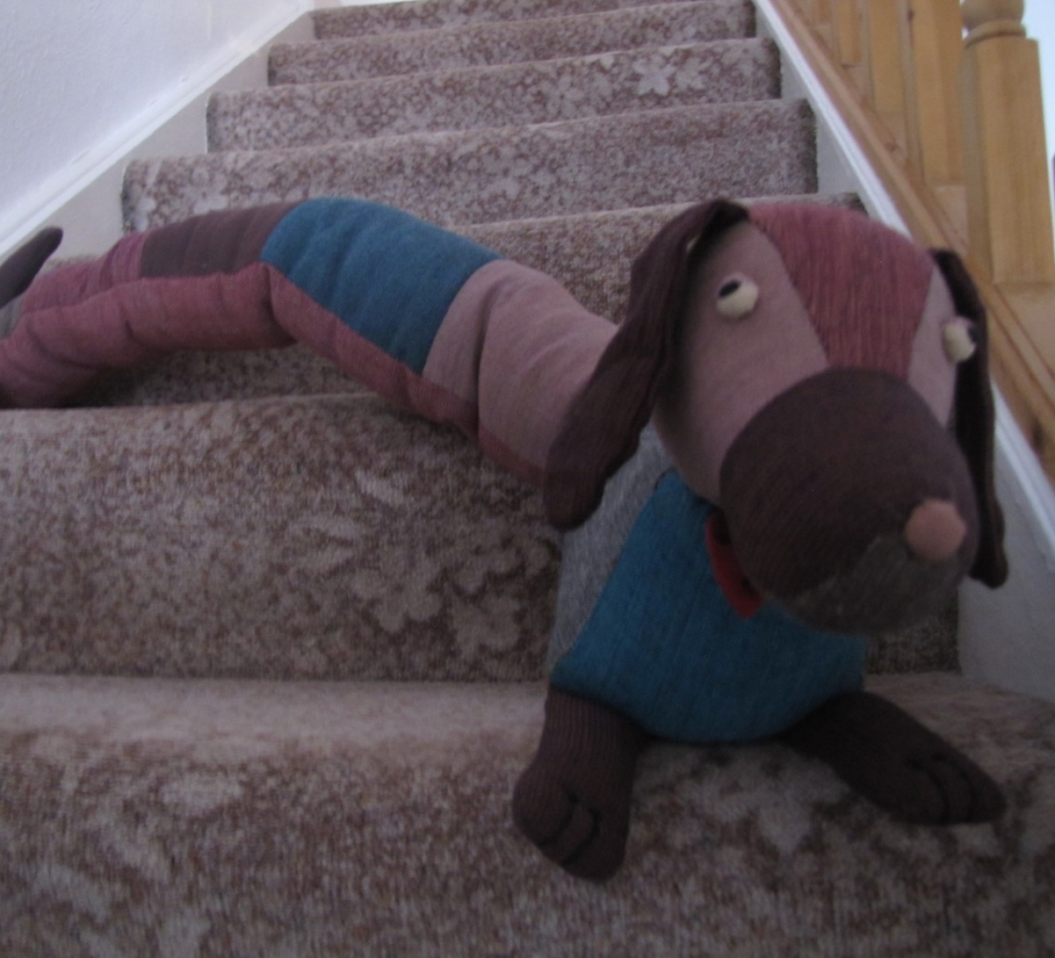
Going down was harder, because his back legs kept trying to overtake his front legs.

Slide 12
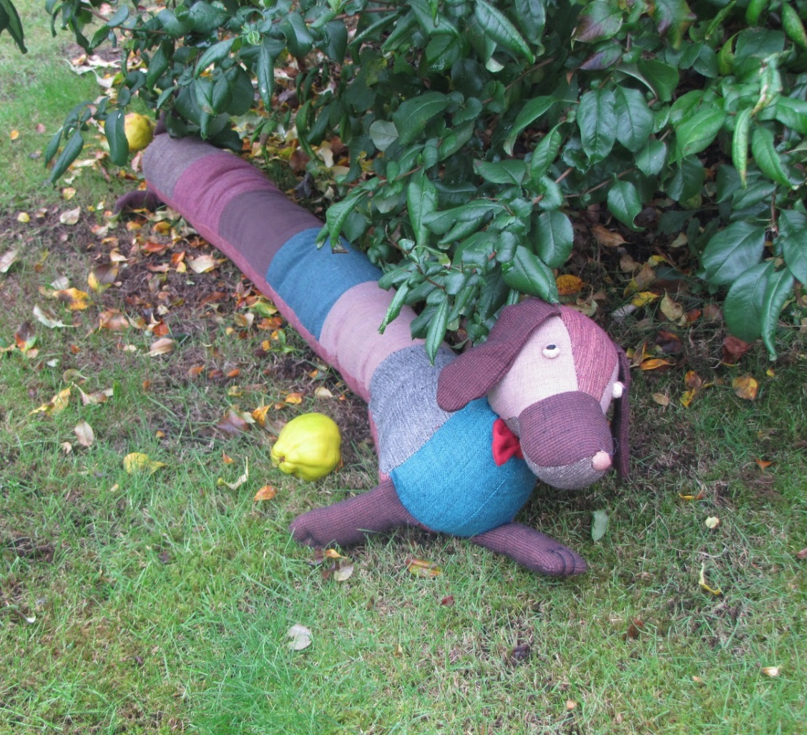
Fran took the dog into the garden. It was cold and damp outside. It was late autumn.

Slide 13
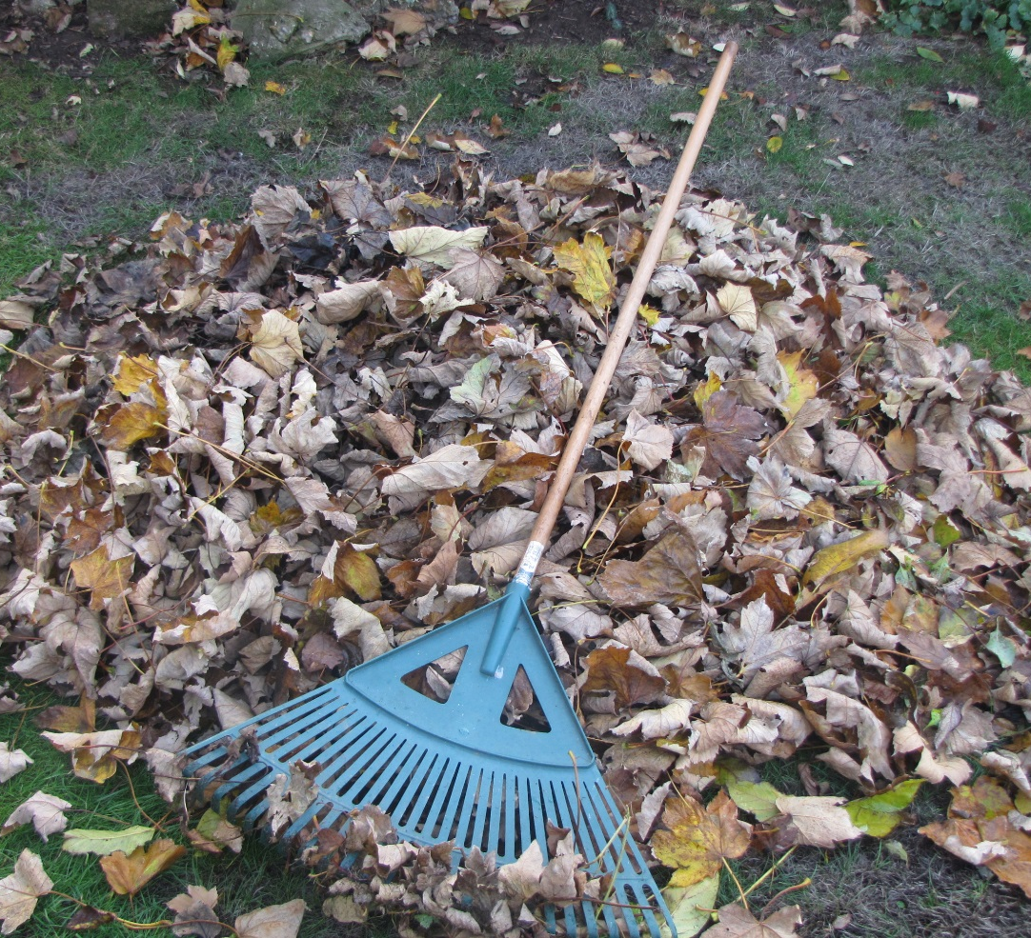
Suddenly Fran dropped the dog under a quince bush and went to kick up leaves. Some of them fell on the dog.

Slide 14
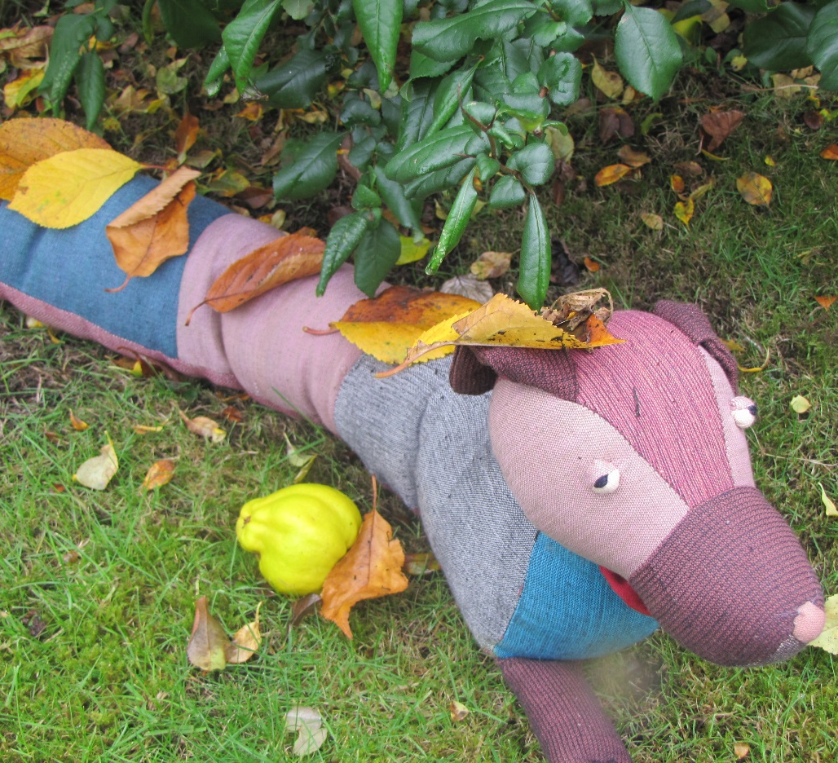
Just then Granny called Fran into the kitchen. “Where is the dog you took out with you?” asked Granny.

Slide 15
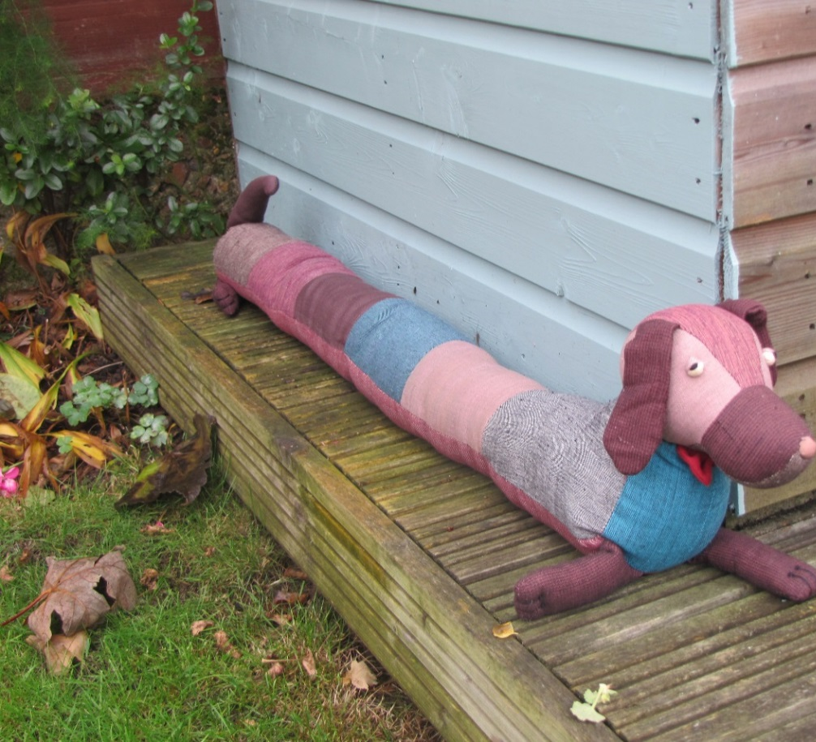
“Brush all the leaves off the dog before you bring him back.” called Granny. Fran put the dog down by the shed and brushed them off.

Slide 16
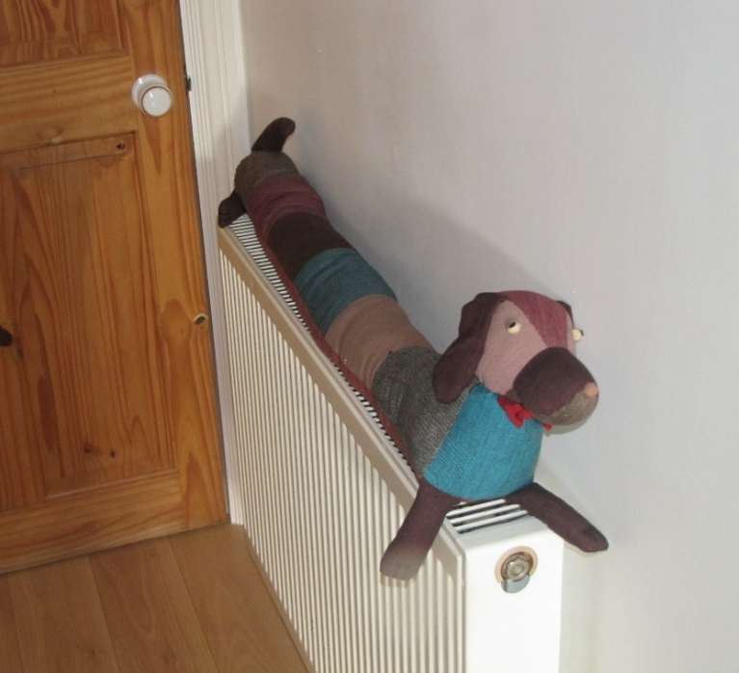
“Put the dog on the radiator to dry off,” said Granny.
“What is the dog’s name?” asked Fran.
“He hasn’t got one yet,” said Grandad.

Slide 17
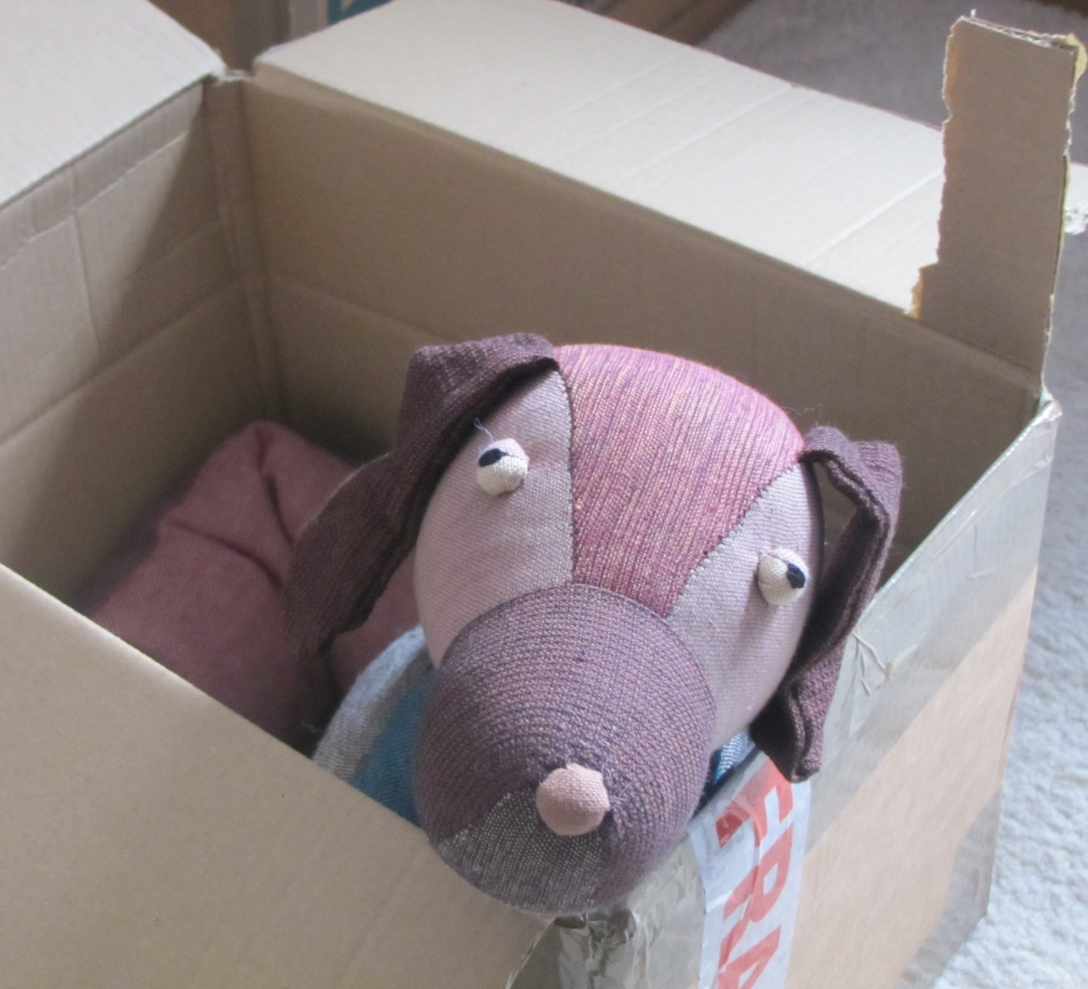
James thought names should describe things as they are, so he said, “We could call him ‘stuffed toy’.”
“No, I don’t like that name,” said Granny.

Slide 18
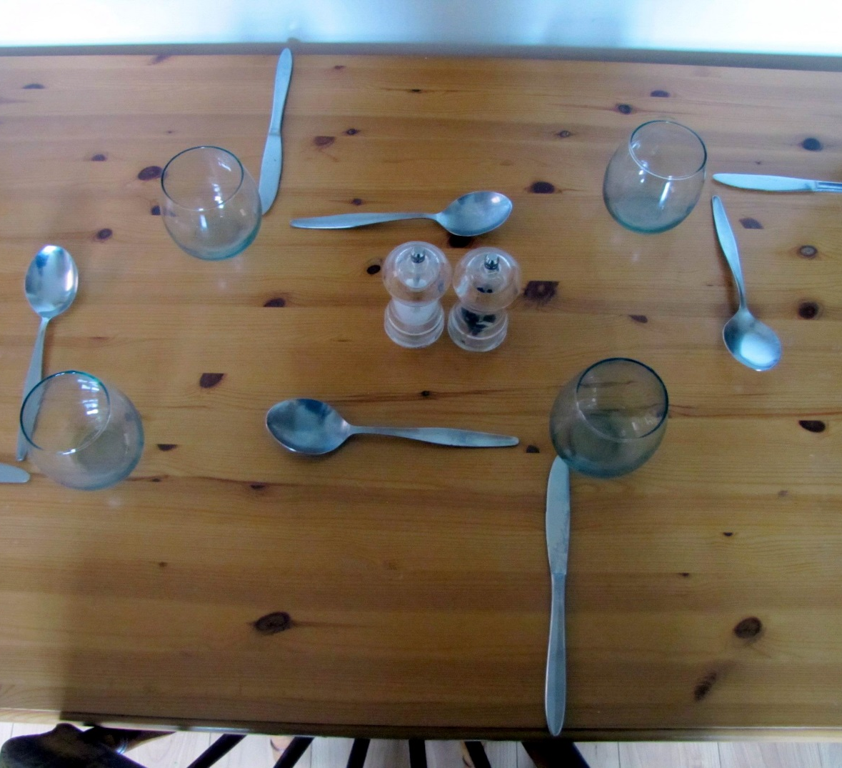
“Stuffed toy is a rotten name. How would you like to be called ‘annoying older brother’?” said Fran.
“Have you finished setting the table?” asked Granny.

Slide 19
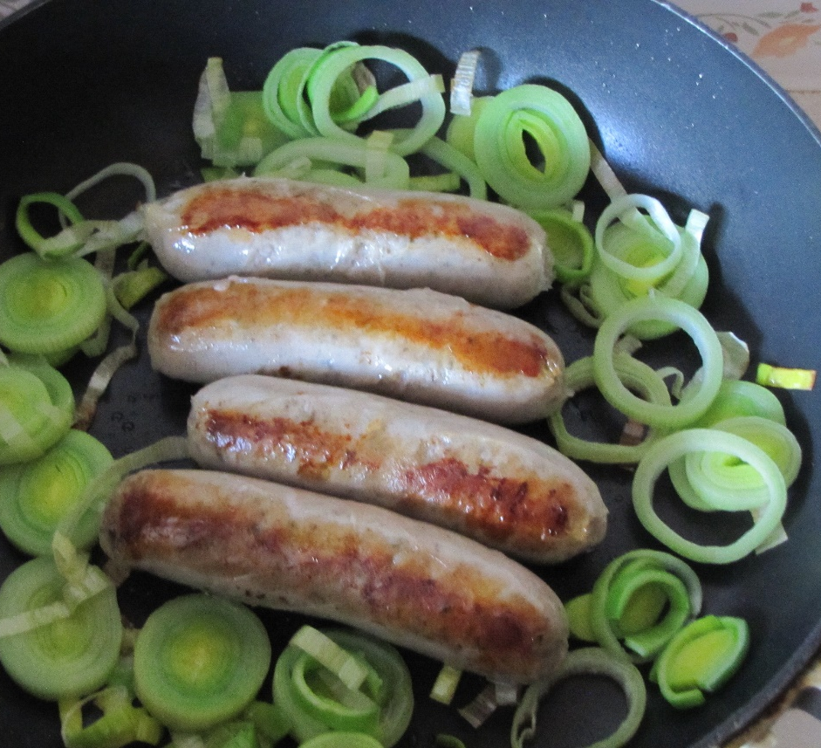
Grandad was cooking sausages for lunch, “Why don’t we call the dog Cumberland?” he said.

Slide 20
Marmaduke
They talked about other names but they decided that none of them fitted. “So Cumberland it is,” said Grandad.
James laughed.
Older brothers can be really annoying.
Spot
Bonzo

Slide 21

Cumberland

Slide 22
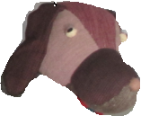
Notes for parents and teachers
Cumberland comes from a Fairtrade cooperative in Nepal and his journey to his new home was enabled by Traidcraft plc.
This book could be about the importance of names and why we choose names carefully.
It could be about annoying older brothers or having a nice time with families and the giving and receiving of love.
Better still it might be about whatever those who hear the story think it is about, but you will only discover what
children think it is about by talking with them.
This book is one of a series about Cumberland and his world that raise questions about, love, joy, feeling alone,
enjoying company, being sad and being happy.
You might follow this story with talking about names within the family, perhaps even making a family tree, showing
the names in each generation. There might be special reasons why some names have been given, although it is
unlikely that they will be linked to sausages.

Slide 23
Published 2018 in association with Bear Lands Publishing, St. Mary’s Centre, Llys Onnen, Abergwyngregyn, Gwynedd, LL33 0LD, Wales.
Copyright © 2018 David W. Lankshear (text and illustrations).
David W Lankshear has asserted his right under the Copyright, Design and Patents Act 1988 to be identified as the author of this Work.
All rights reserved. No part of this publication may be reproduced, stored in a retrieval system, or transmitted, in any form or by any means, electronic, electrostatic, magnetic tape, mechanical, photocopying, recording or otherwise, without full acknowledgement of Bear Lands Publishing and copyright holders.
First published 2018

