Slide 1
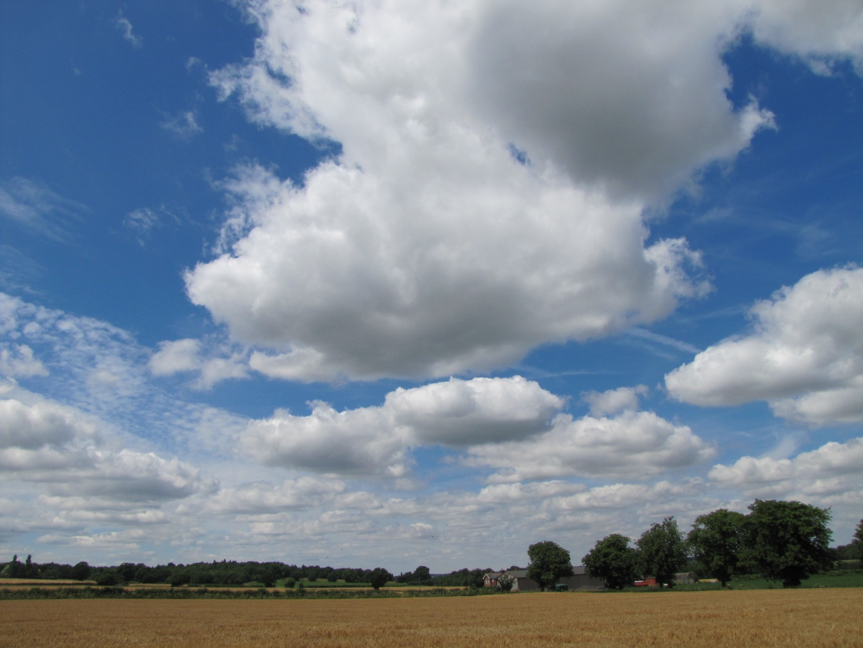
Cumberland and the summer walk
By David W. Lankshear

Slide 2
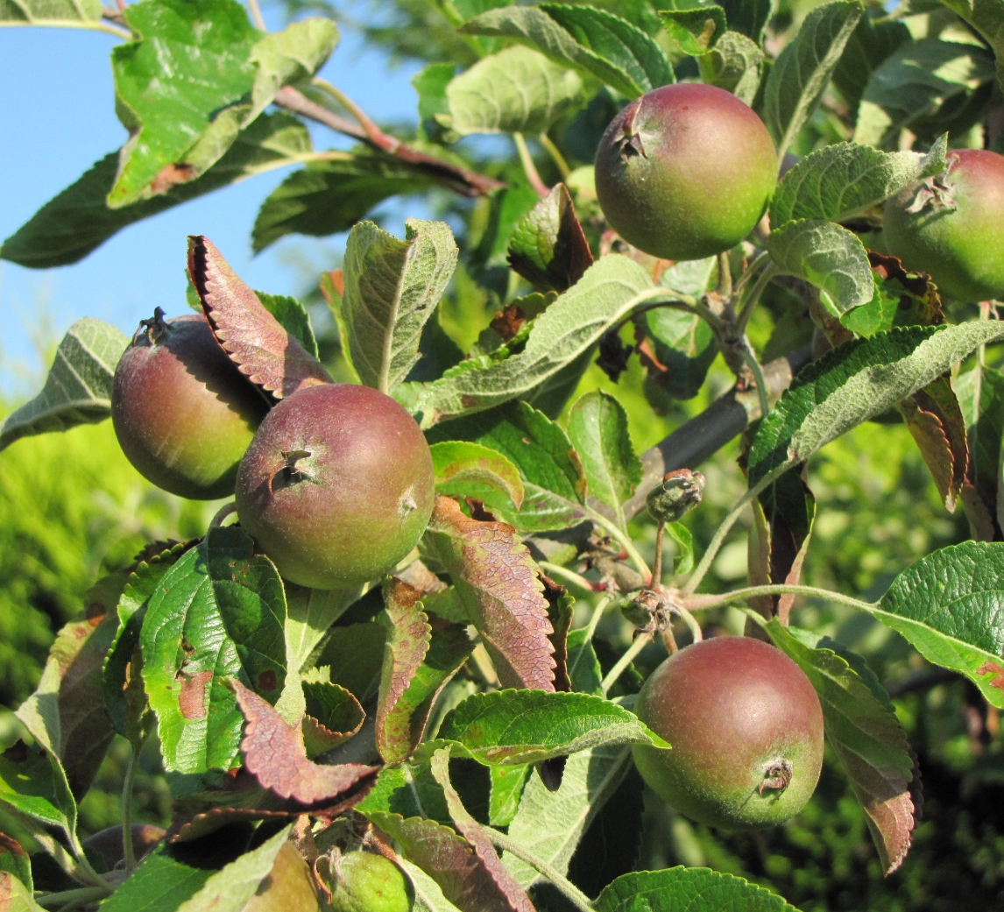
Cumberland and Fran were sitting under Granny’s apple tree. It was near the end of a busy day and Fran was ready to sit still and talk to Cumberland. She had been for a walk.

Slide 3
“I enjoyed our walk today,” said Fran, “It was a long way, but there weren’t many hills and the sky was very big.”

Slide 4
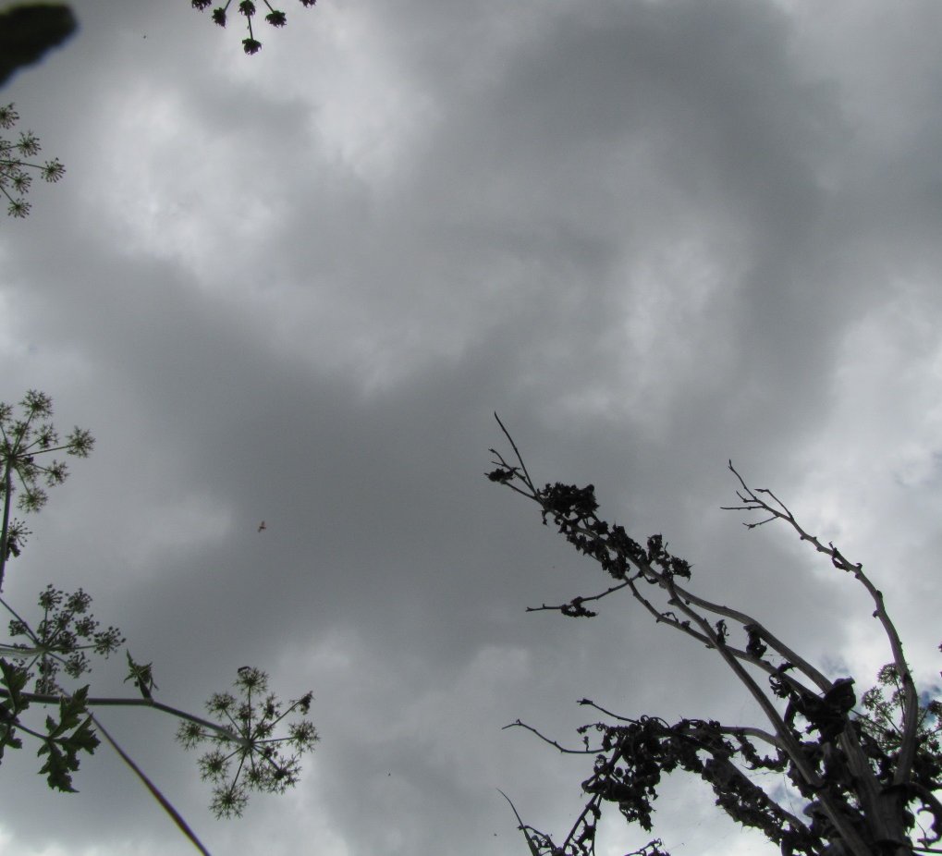
“Once I lay on my back in a field and watched the clouds sail by above me. That was good, but the grass I was laying on was prickly.”

Slide 5
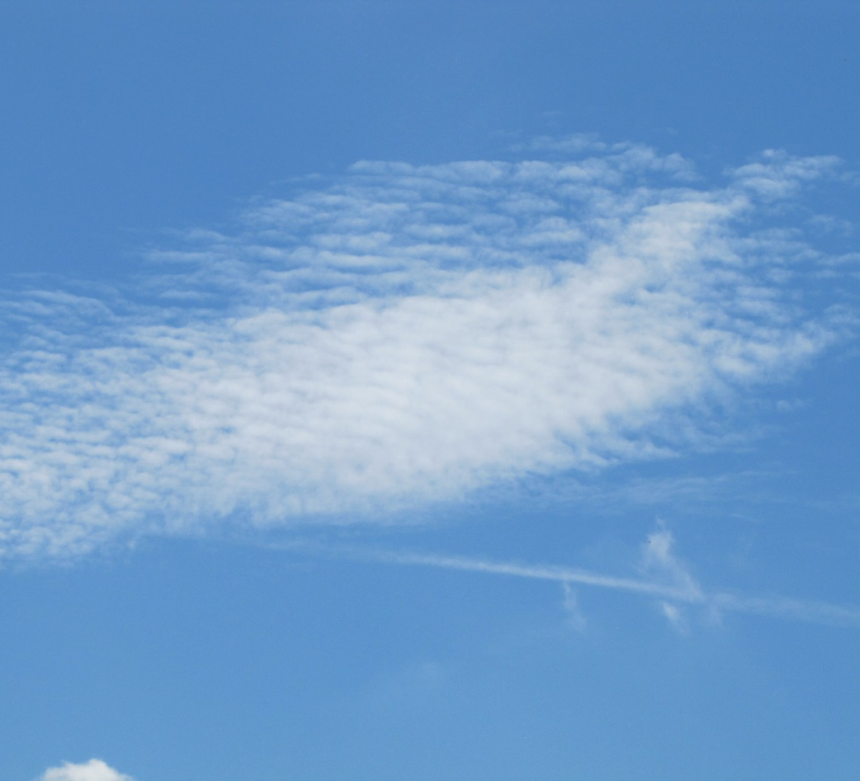
“I liked looking at the clouds in the sky. They looked like a magic land.”

Slide 6
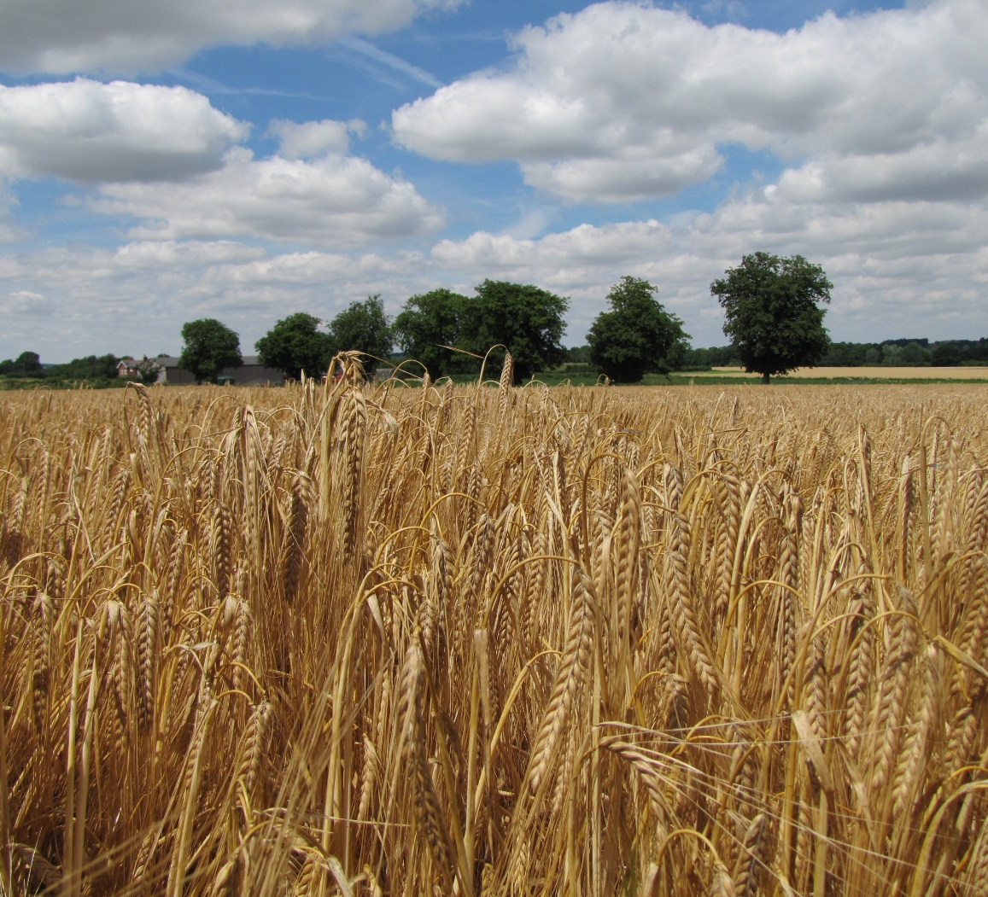
“I liked looking at the ripe grains of barley in the field. They look like a sea of gold.”

Slide 7
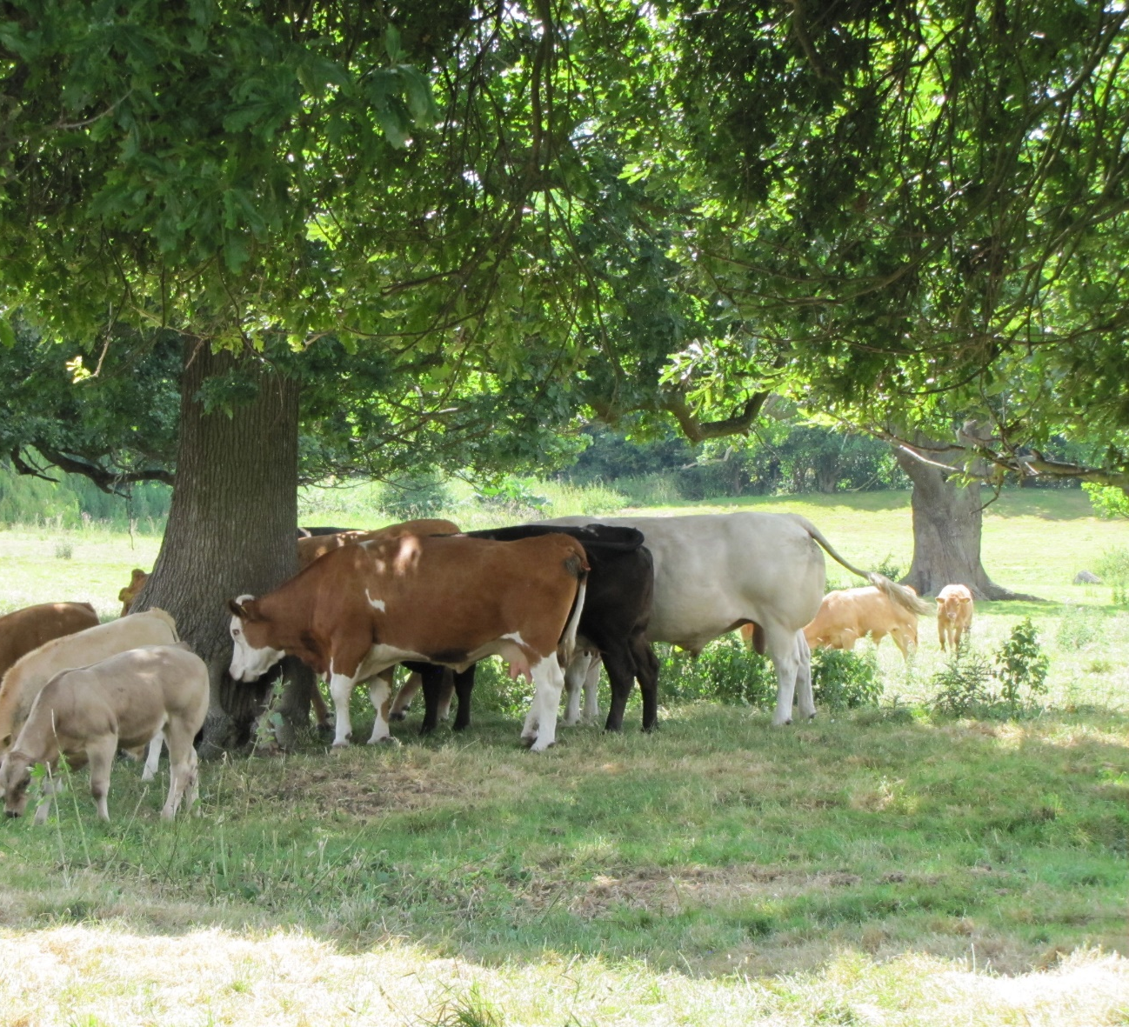
“I liked looking at the cows with their calves. They looked so contented and calm.”

Slide 8
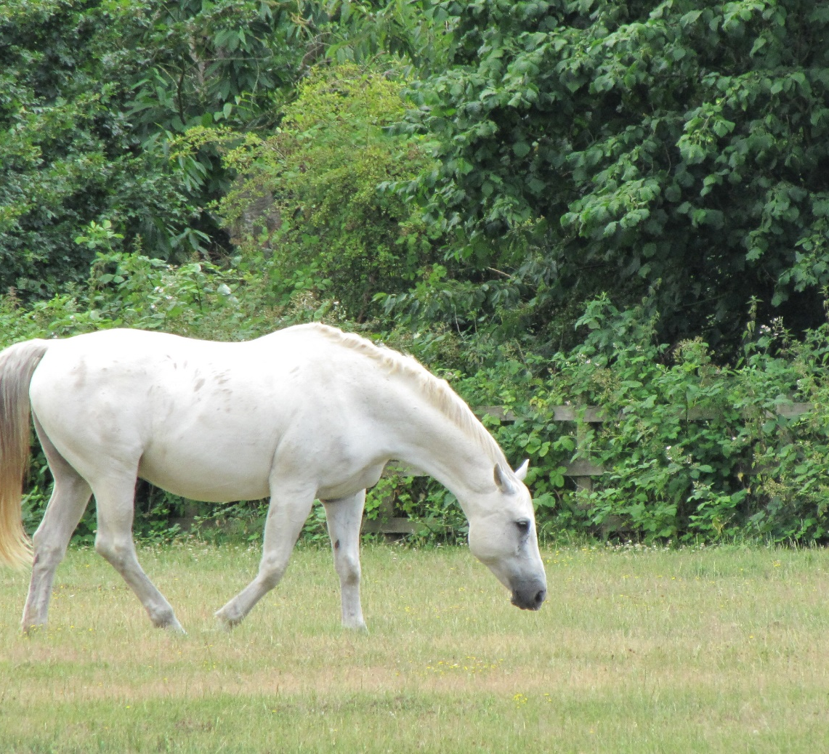
“I liked looking at the horses. The white horse looked so strong and fit.”

Slide 9
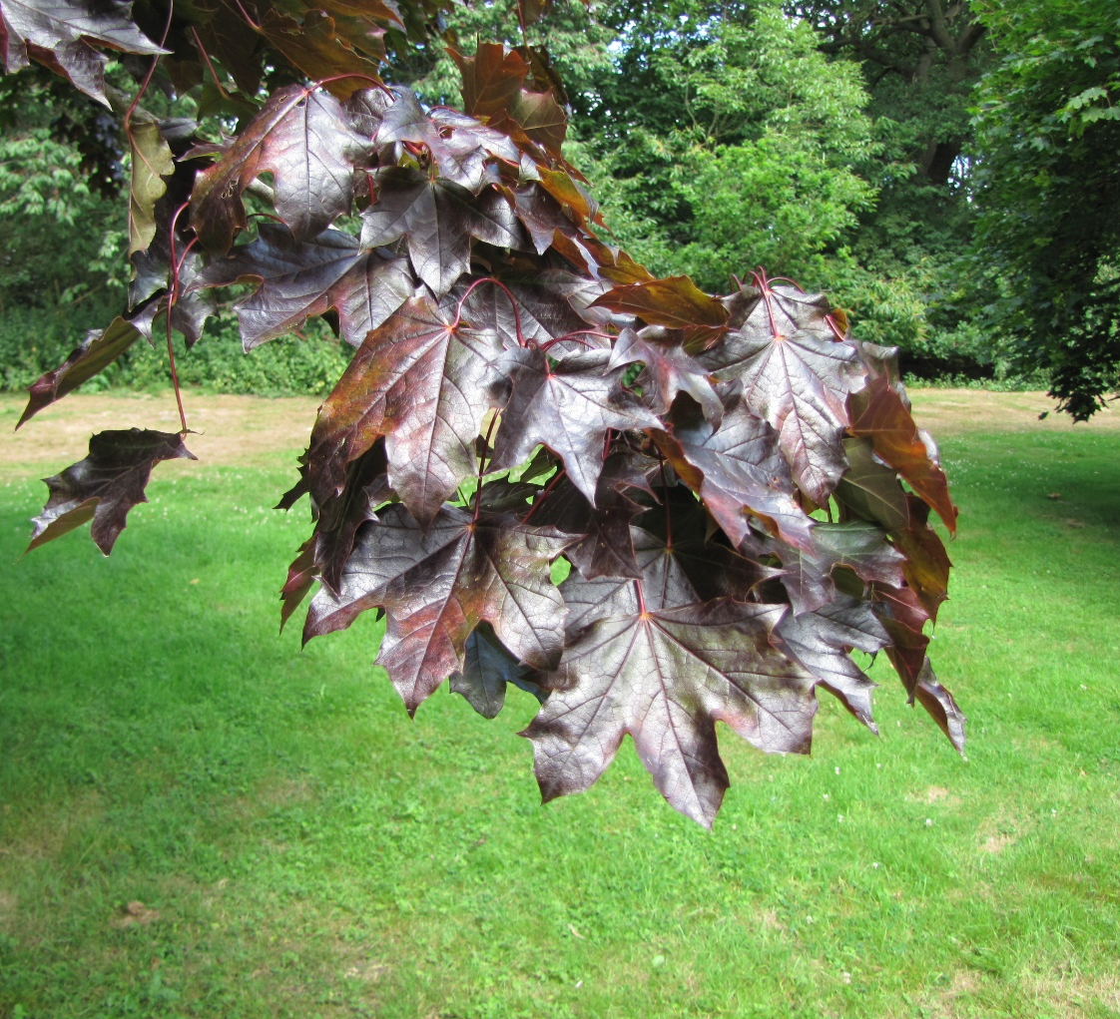
“I liked looking at the richly coloured leaves. They looked like dark shining metal.”

Slide 10
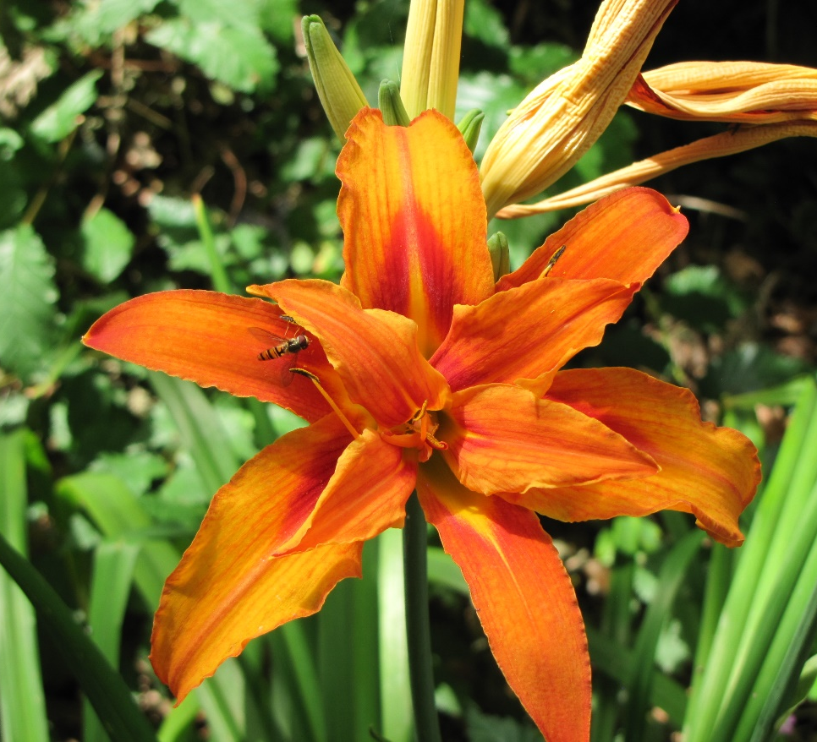
“I liked looking at the flowers. The orange flower looked as bright as the sun.”

Slide 11
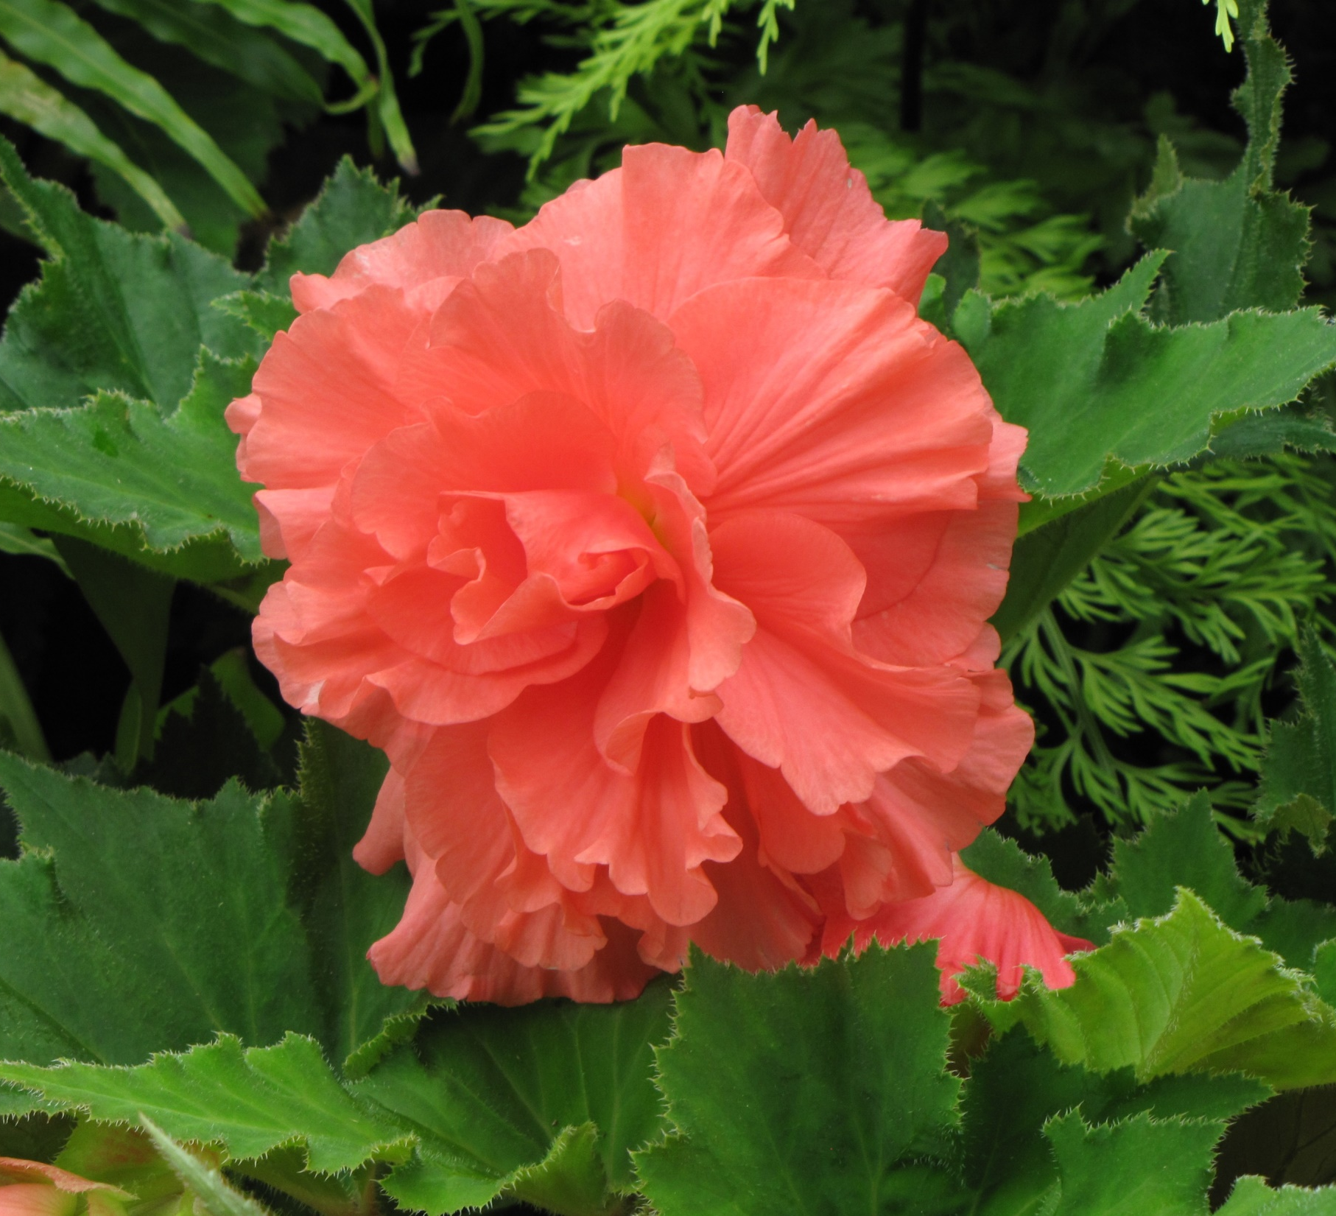
“I liked looking at the pink flower. It looked like icing for a cake.”

Slide 12
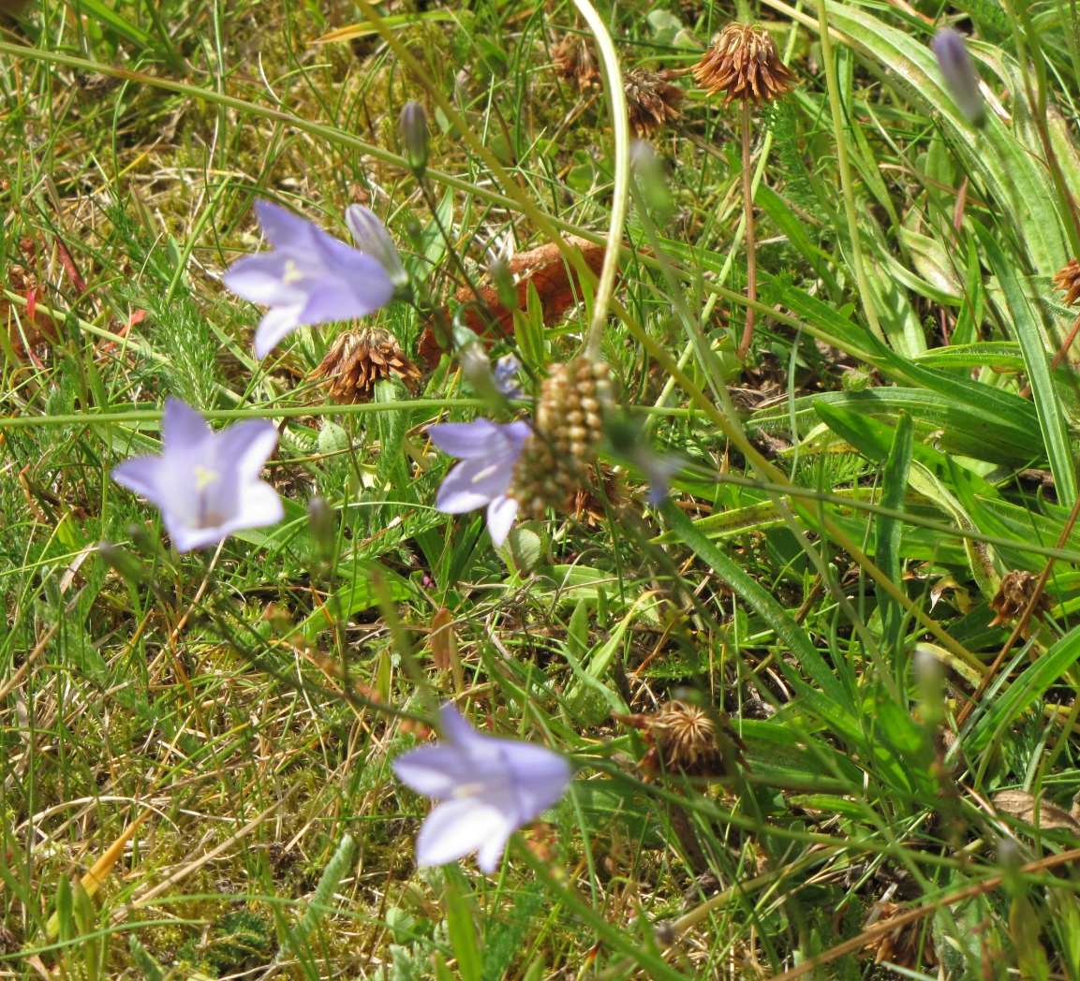
“I liked looking at the blue flowers. They looked so soft and tiny amid the grass.”

Slide 13
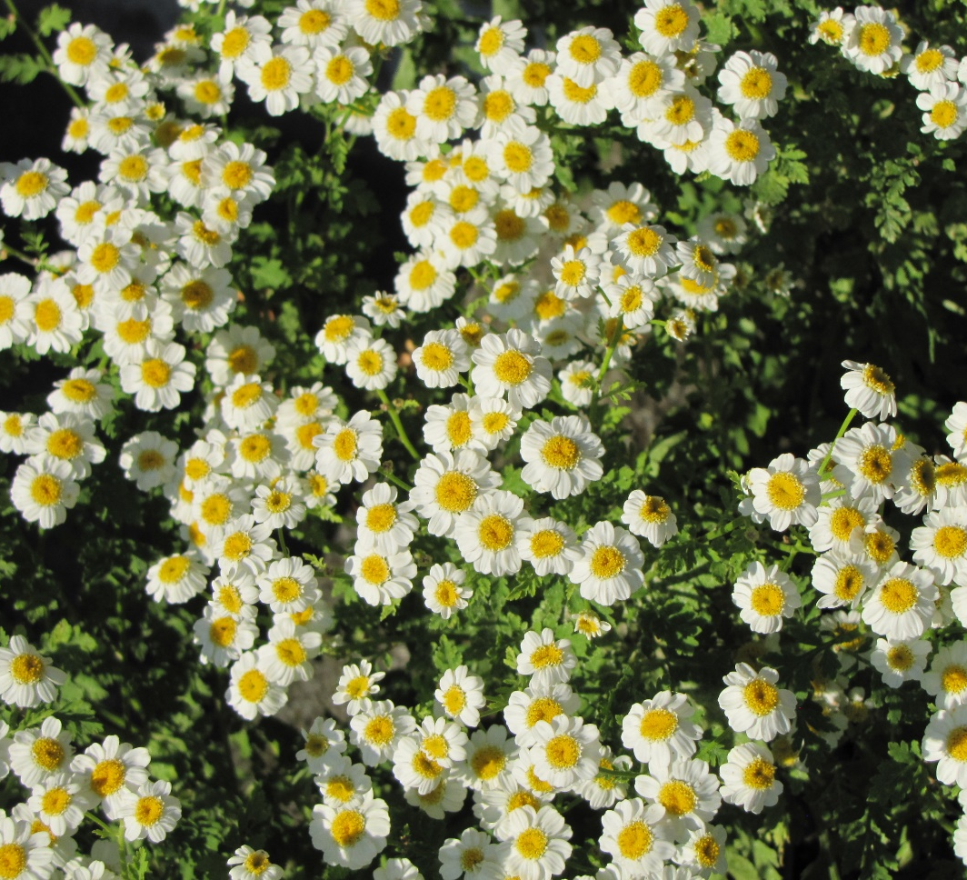
“I liked looking at the daisies growing close together. There were too many to count.”

Slide 14
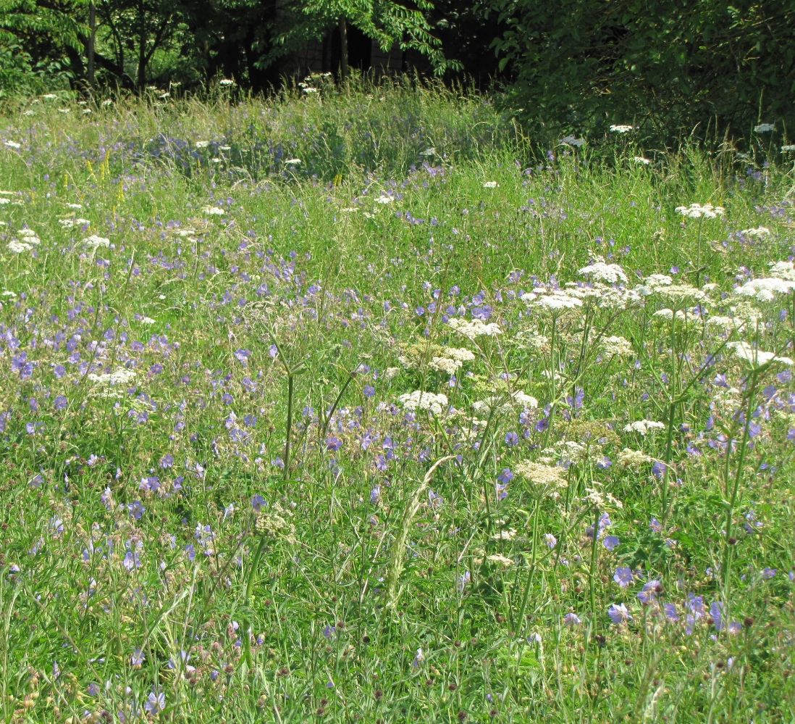
“I liked looking at the flowers when they were all growing together in a field.”

Slide 15
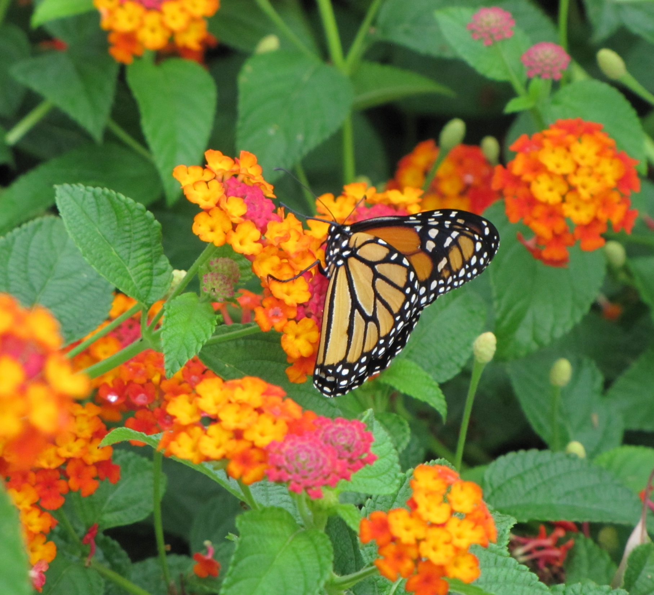
“I liked looking at the butterfly. The patterns on its wings were amazing.”

Slide 16
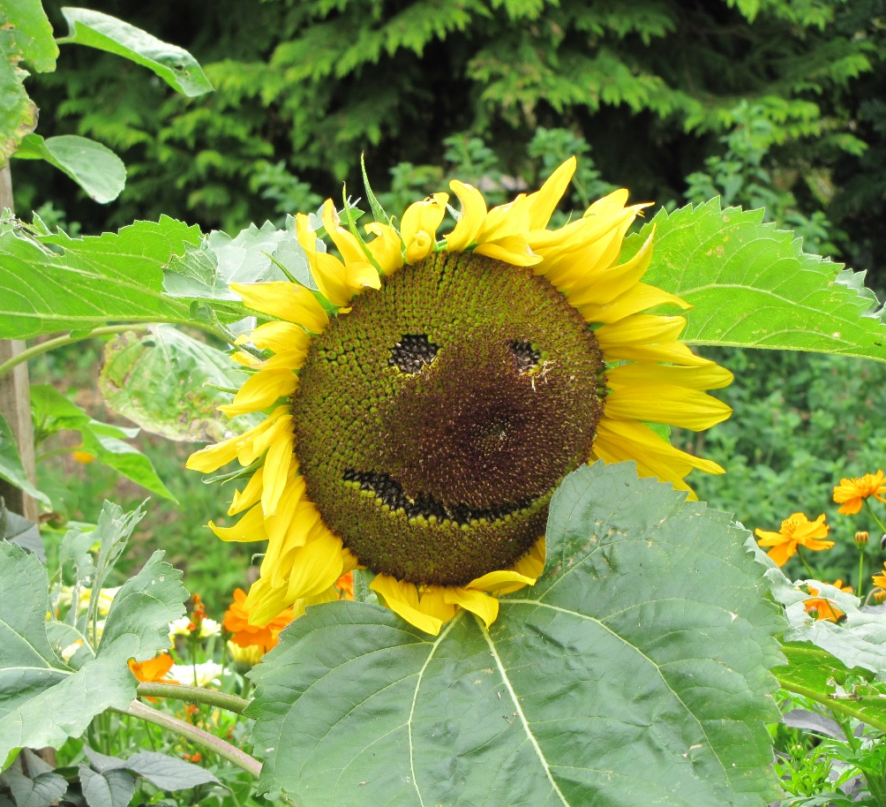
“I liked looking at a sunflower that someone had made into a face. It was funny.”

Slide 17
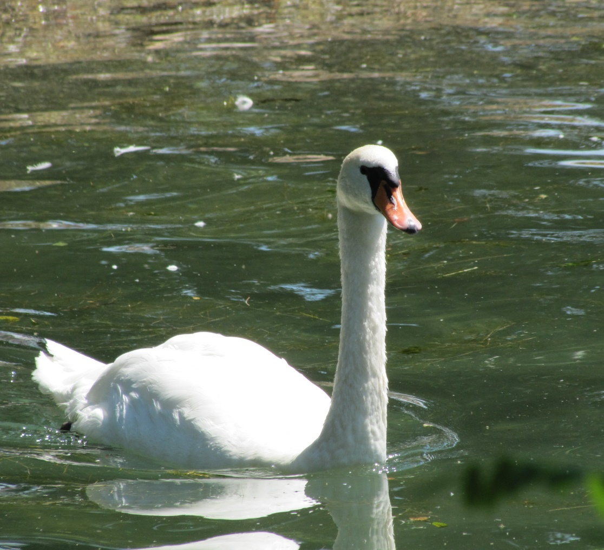
“I liked watching the swans on the lake. They seem to glide across the water.”

Slide 18
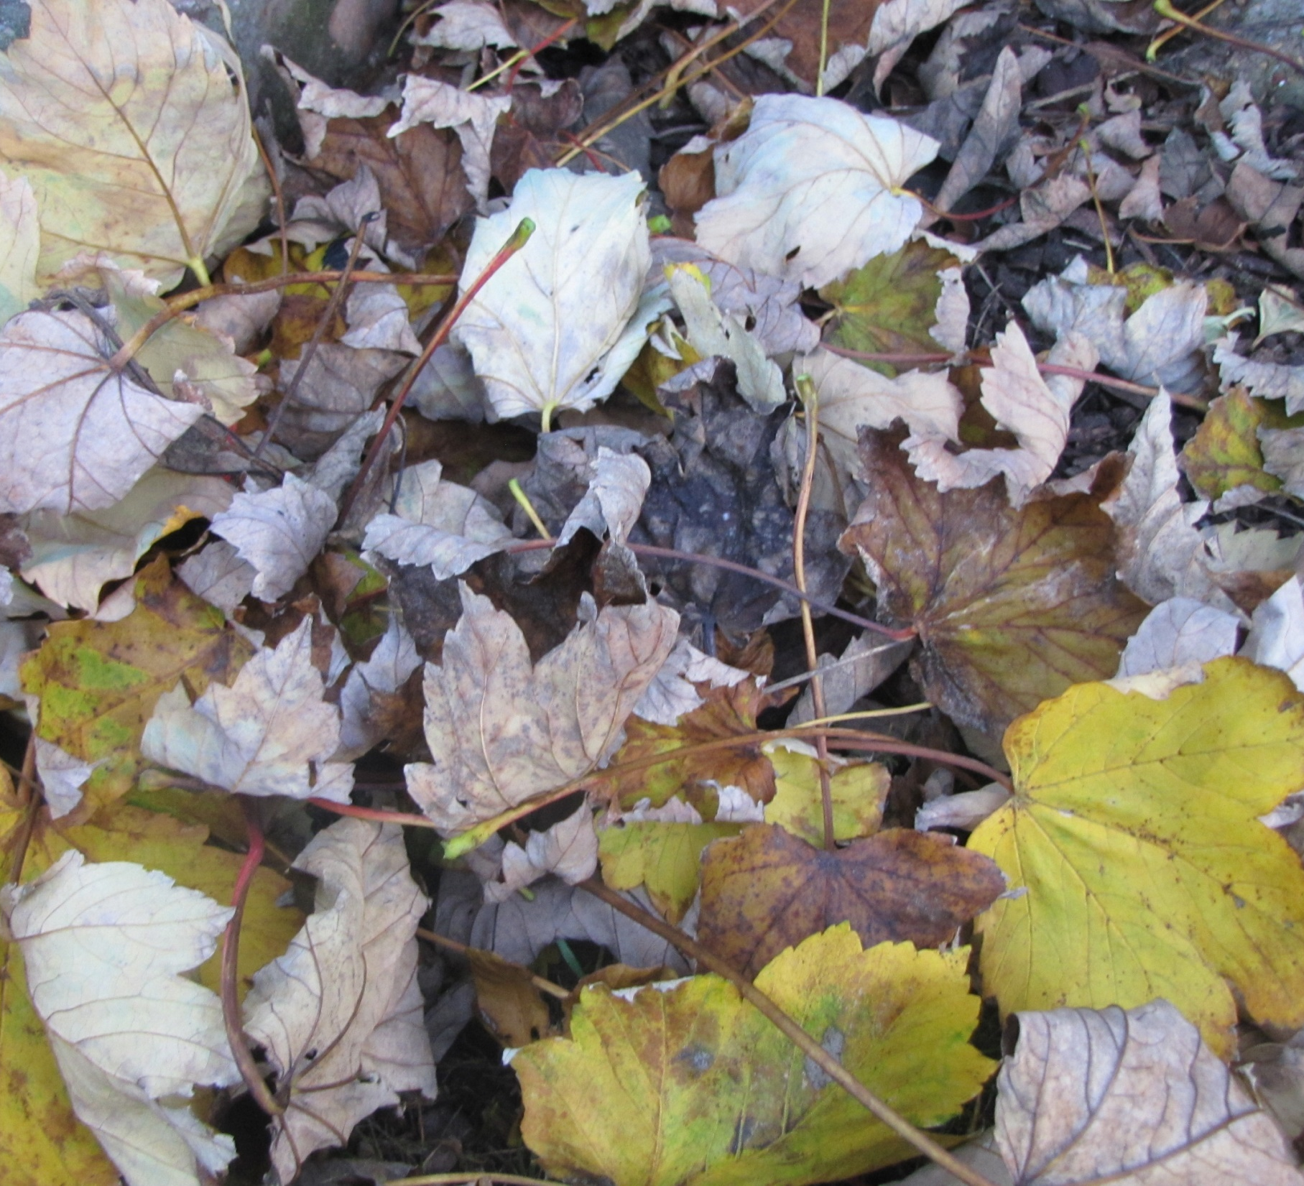
“I liked looking at the dead leaves. I also liked crunching them under my feet.”

Slide 19

“I have been telling you what I liked on my walk. What do you like Cumberland?” asked Fran.

Slide 20
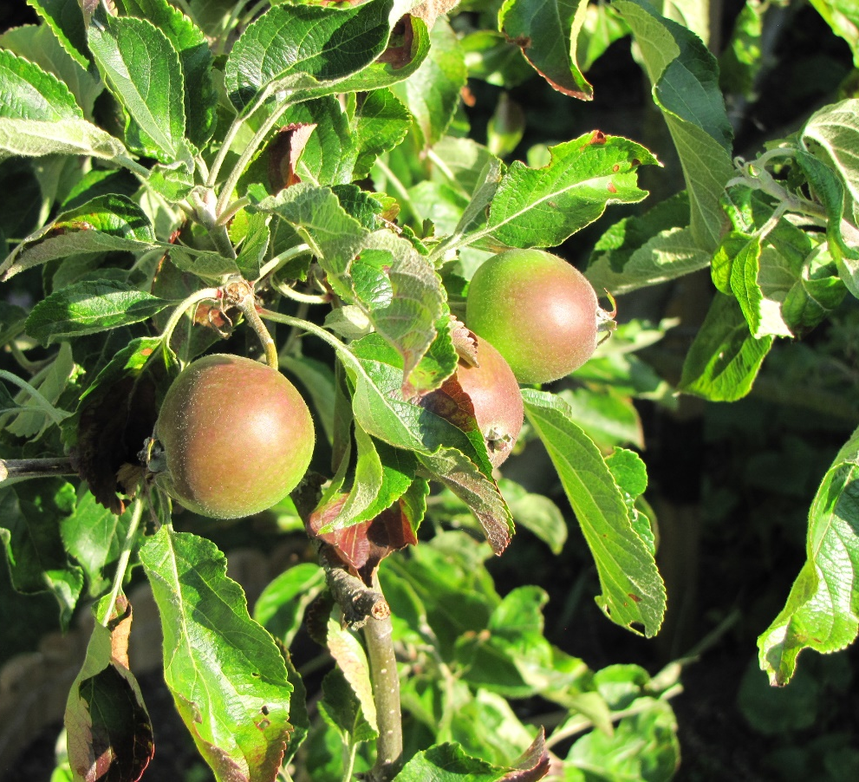
Cumberland thought for a bit and he decided that he liked sitting under Granny’s apple tree listening to Fran talking.

Slide 21
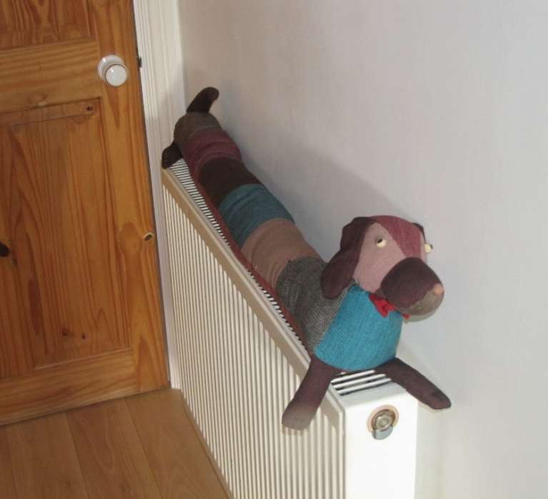
But he also liked sitting on the radiator, getting nice and warm.

Slide 22
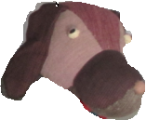
Notes for parents and teachers
Cumberland comes from a Fairtrade cooperative in Nepal and his journey to his new
home was enabled by Traidcraft plc.
This book is about what we think is beautiful or what we like and stopping to consider
these. It might also be about all the nice secrets and talks that children share with their
cuddly toys, which as adults we rarely are privileged to hear. Of course, for the child or
children that you read this book with, it could be about something else entirely. That is
the fun of books.
Most of the pictures in this book were taken during a single Saturday morning walk in
high summer in an area of Great Britain not well known for it’s natural beauty.

Slide 23
Published 2018 in association with Bear Lands Publishing, St. Mary’s Centre, Llys Onnen, Abergwyngregyn, Gwynedd, LL33 0LD, Wales.
Copyright © 2018 David W Lankshear (text and illustrations).
David W Lankshear has asserted his right under the Copyright, Design and Patents Act 1988 to be identified as the author of this Work.
All rights reserved. No part of this publication may be reproduced, stored in a retrieval system, or transmitted, in any form or by any means, electronic, electrostatic, magnetic tape, mechanical, photocopying, recording or otherwise, without full acknowledgement of Bear Lands Publishing and copyright holders.
First published 2018

